Slide 1

Social Capital and Economic Mobility
Raj Chetty*, Matthew Jackson*, Theresa Kuchler*, Johannes Stroebel*
Nathan Hendren, Robert Fluegge, Sara Gong, Federico González, Armelle Grondin Matthew Jacob, Drew Johnston, Martin Koenen, Eduardo Laguna-Muggenburg Florian Mudekereza, Tom Rutter, Nicolaj Thor, Wilbur Townsend, Ruby Zhang Mike Bailey, Pablo Barberá, Monica Bhole & Nils Wernerfelt

Slide 2
Measurement of
Social Capital
Association with Economic Mobility
Determinants of Economic Connectedness
Targeting Interventions
Determinants of Economic Connectedness

Slide 3


Why Do Low-Income People Have Fewer High-SES Friends?
Exposure
Friending Bias
vs.
Segregation by Income
Interaction Conditional on Exposure
School A
School B
School A
School B
High-SES
Low-SES

Slide 4
Exposure vs. Friending Bias
Demarcation between exposure and friending bias depends on how we define the groups where people interact
Friending bias within schools may itself arise from differences in exposure (e.g., across classrooms)
→ Distinction is policy-dependent rather than conceptual
School-level grouping has policy relevance: many efforts to integrate schools, neighborhoods, etc.

Slide 5
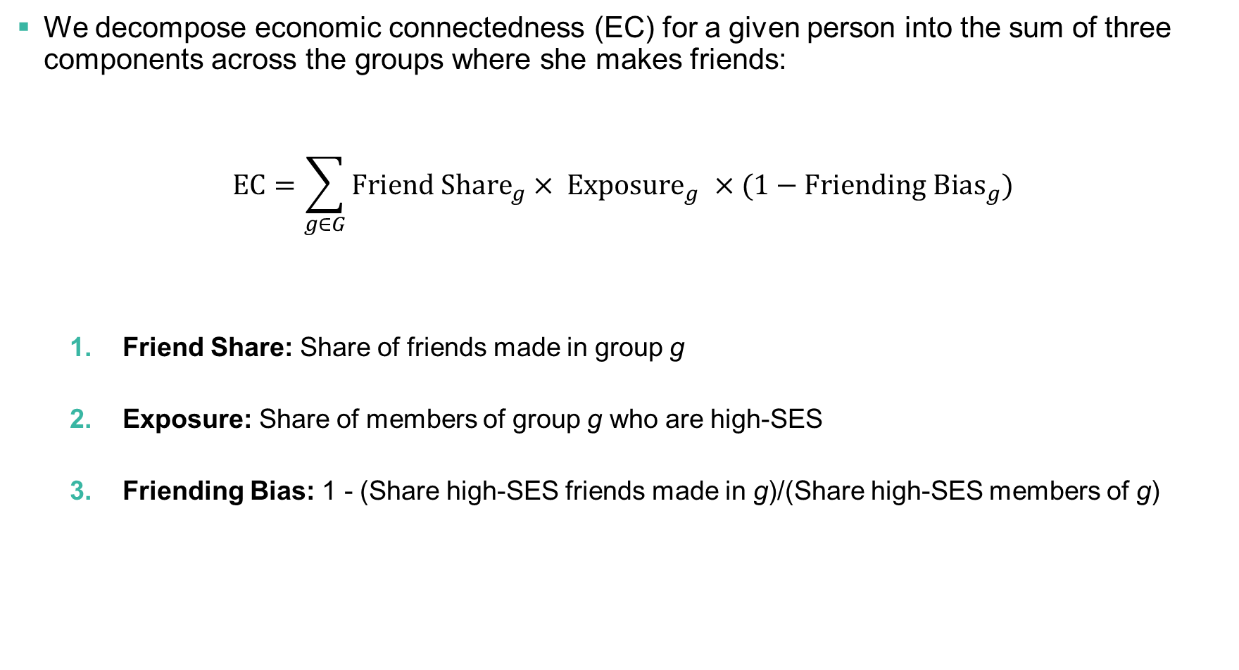
Measuring the Importance of Exposure vs. Friending Bias
We decompose economic connectedness (EC) for a given person into the sum of three components across the groups where she makes friends:
$$EC=\sum_{g∈G}{{Friend Share}_{g}×{ Exposure}_{g}} ×{ (1−Friending Bias}_{g})$$
Friend Share: Share of friends made in group g
Exposure: Share of members of group g who are high-SES
Friending Bias: 1 - (Share high-SES friends made in g)/(Share high-SES members of g)

Slide 6






Assign Friendships to One of Six Settings Where They are Formed
High Schools
Colleges
Workplaces
Recreational Groups
Religious Groups
Neighborhoods

Slide 7
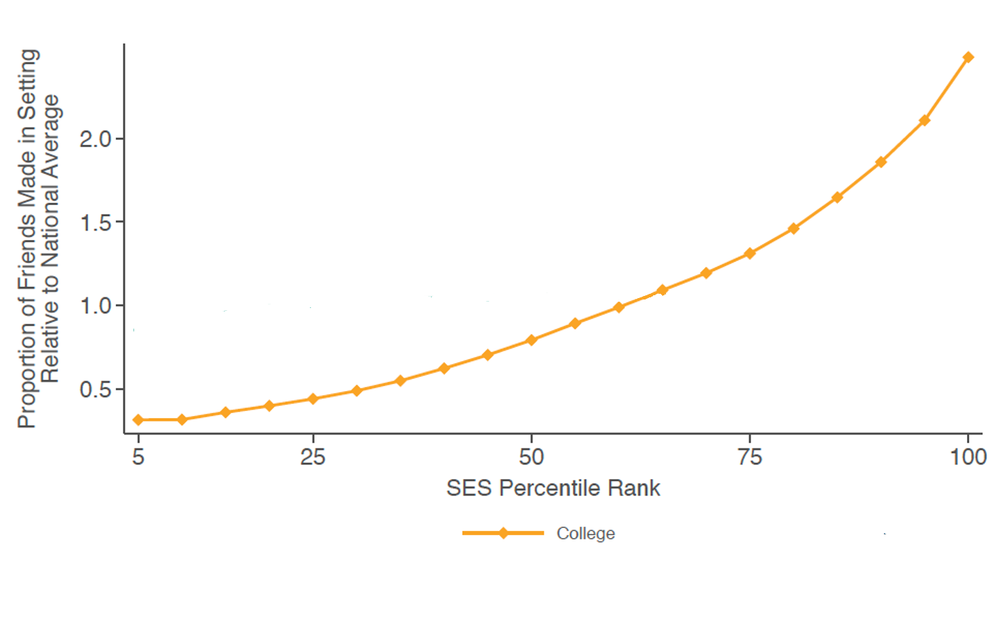
Friendship Shares by Setting vs. Socioeconomic Status
Colleges
Notes:
2-1

Slide 8
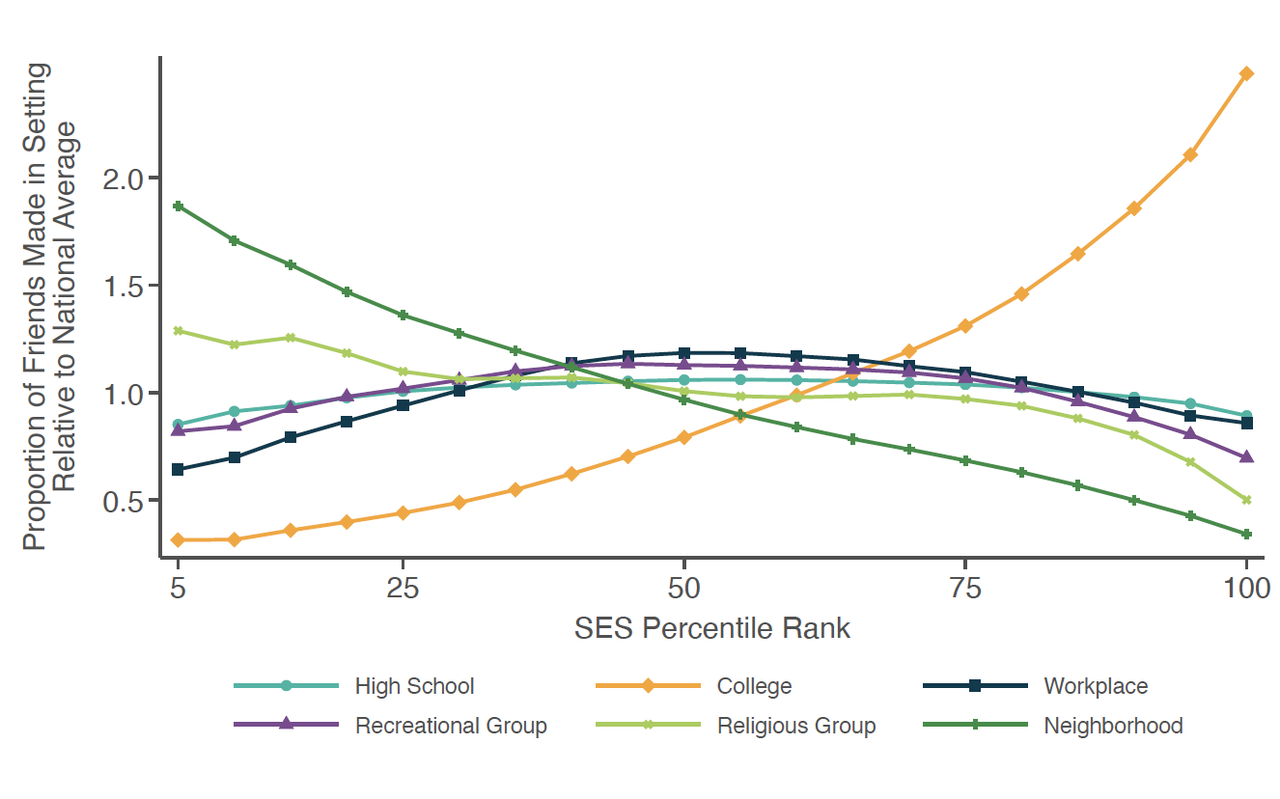
Friendship Shares by Setting vs. Socioeconomic Status
All Settings
Notes:
2-1

Slide 9
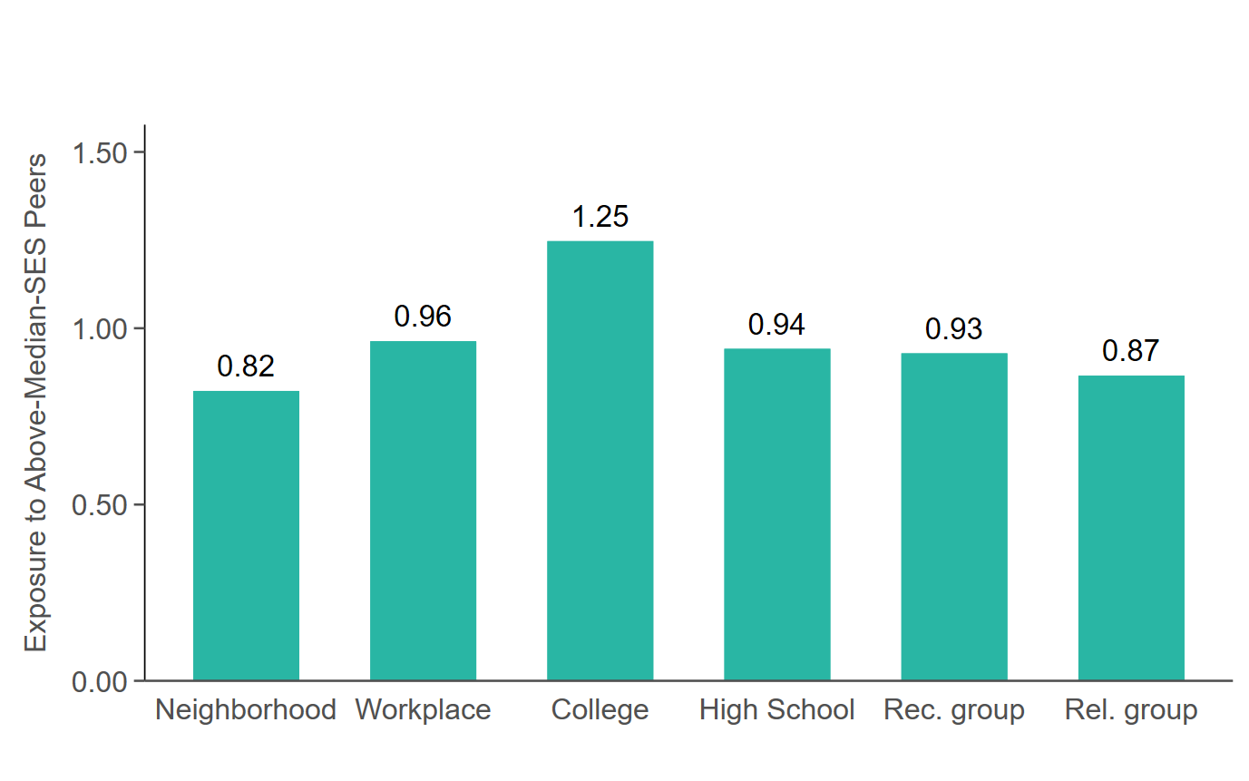
Exposure to Above-Median SES Peers By Setting
Low-SES People
Notes:
2-2B

Slide 10
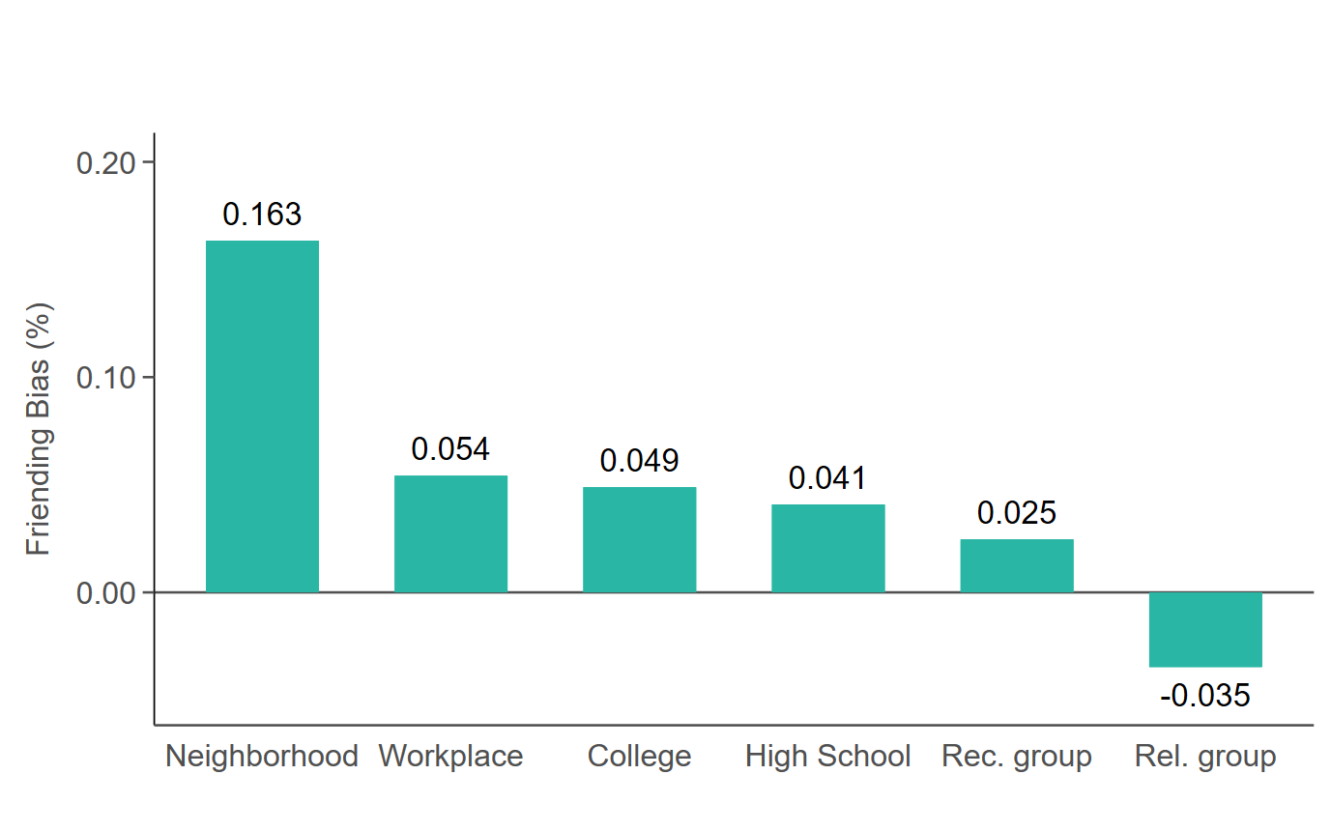
Friending Bias for Low-SES People, By Setting

Slide 11
Measuring the Importance of Exposure vs. Friending Bias
We just measured the mean values of three components that determine connectedness: friend shares, exposure, and friending bias by setting and SES
Now use these parameters to quantify the contribution of each channel in explaining why low-SES people have fewer high-SES friends

Slide 12
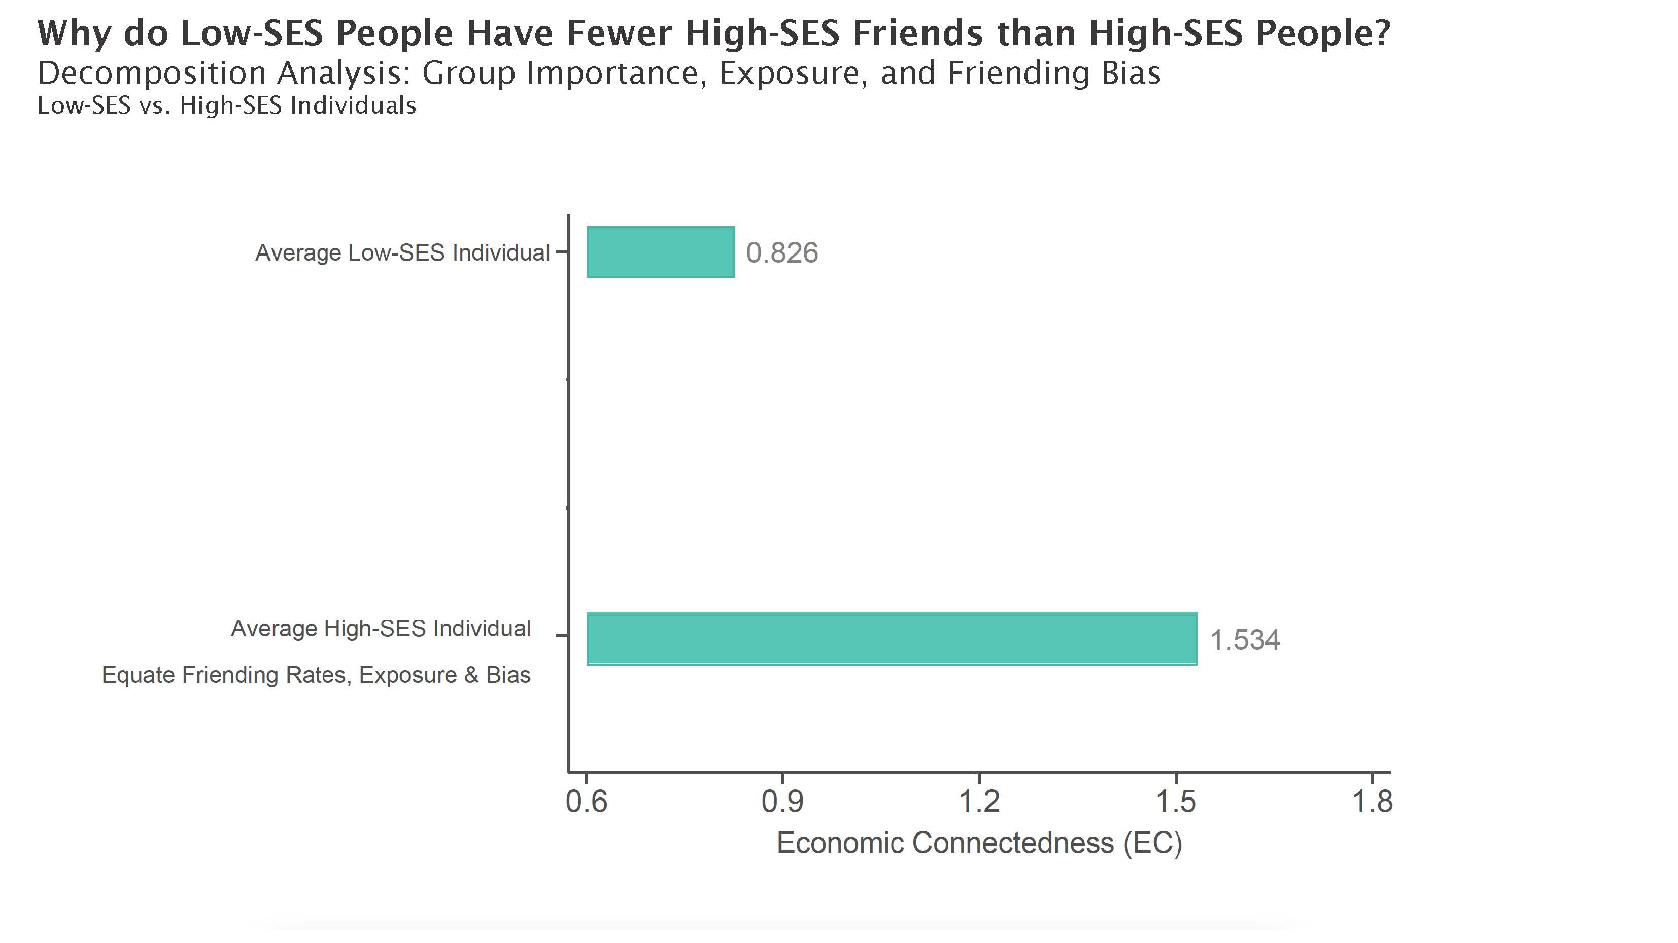
Notes:
2-3A

Slide 13
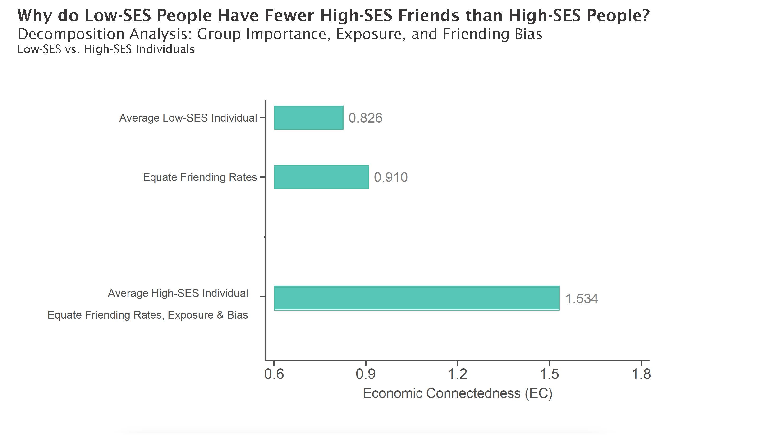
Notes:
2-3A

Slide 14
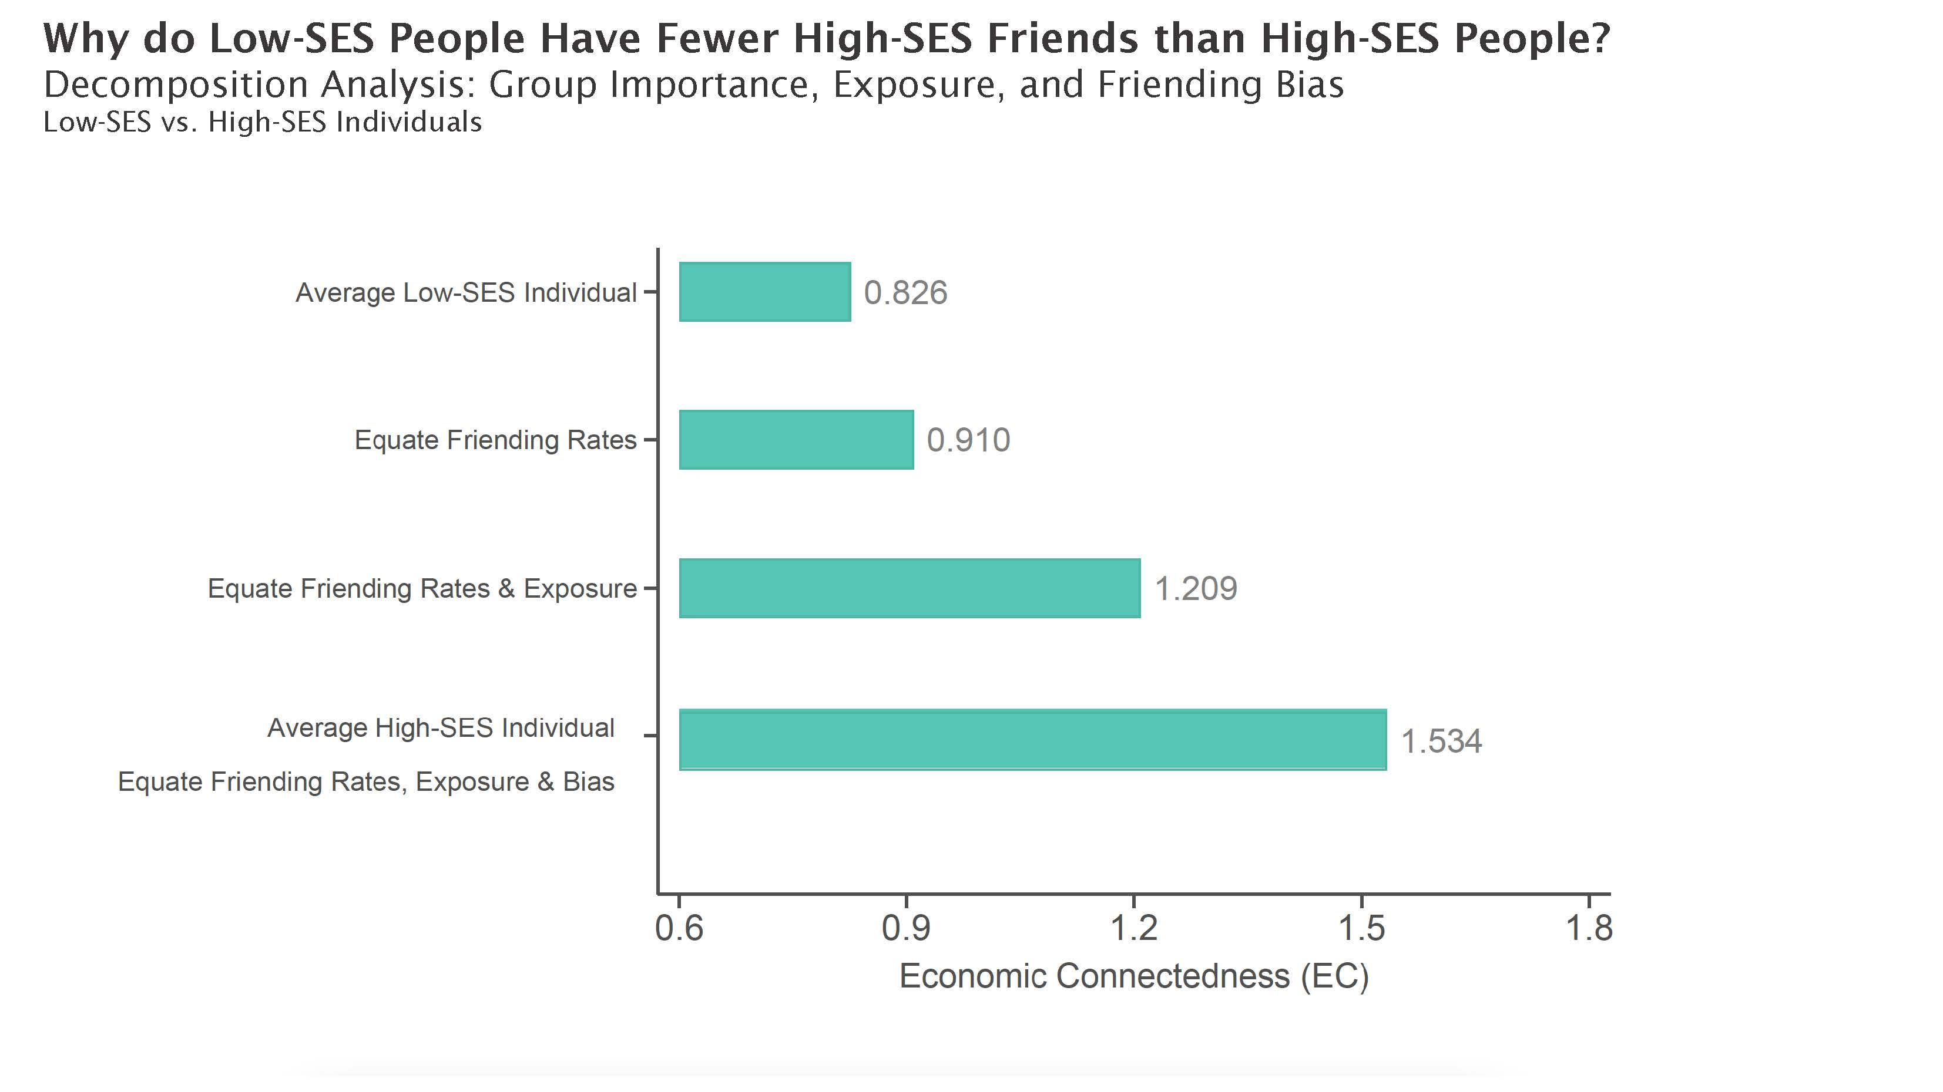
Notes:
2-3A

Slide 15
Measurement of
Social Capital
Association with Economic Mobility
Determinants of Economic Connectedness
Targeting Interventions
Interventions to Increase Connectedness

Slide 16
Friending Bias vs. Exposure to High-SES Students, by High School
Among Low-SES Students in 1990-2000 Birth Cohorts
Exposure Reliability = 99% Friend Bias Reliability = 58%
Notes:
2-5A

Slide 17
Determinants of Exposure and Friending Bias
Well known that exposure is shaped by policies such as zoning laws and school boundaries
Extensive literatures on segregation in neighborhoods (zoning, tipping), school integration (busing, school choice), college access, …
Friending bias is also shaped by institutions and policy choices…

Slide 18
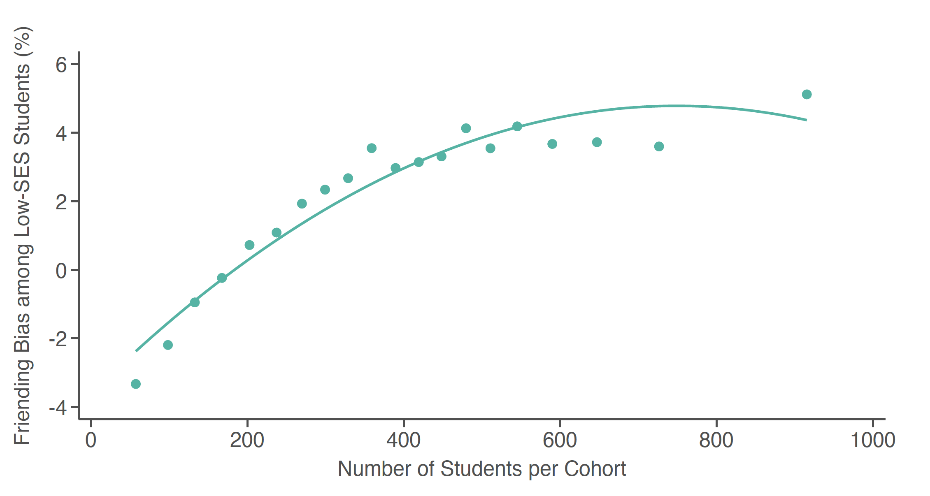
Friending Bias in High Schools vs. School Size
Notes:
2-ED-2C

Slide 19
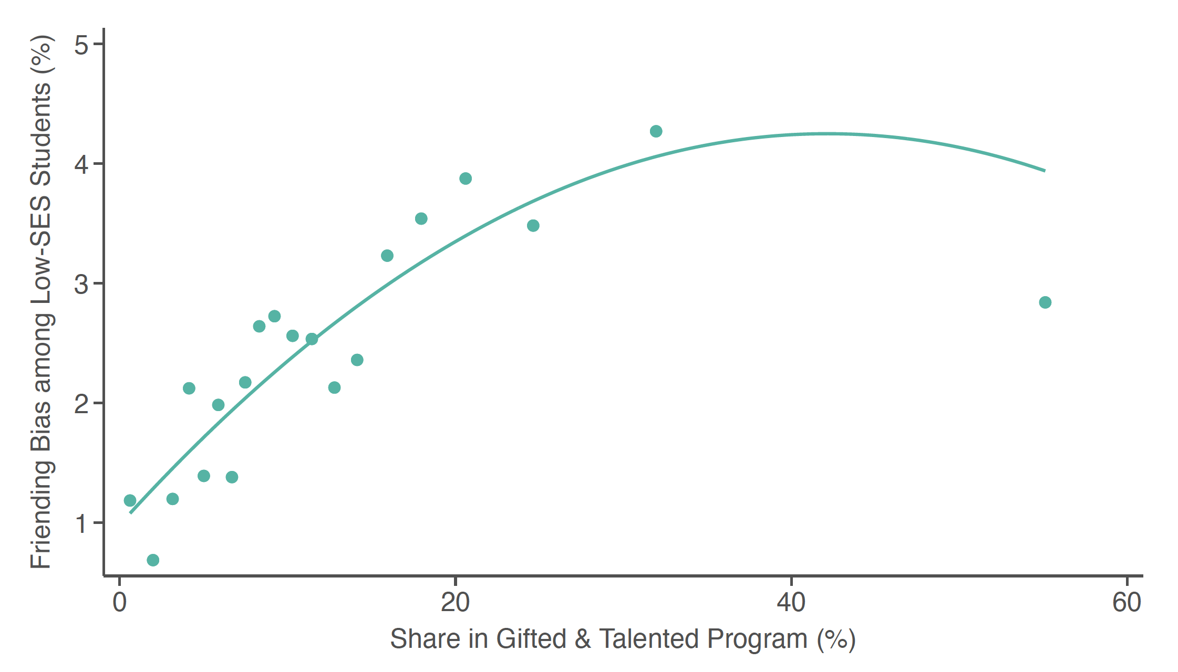
Friending Bias in High Schools vs. Gifted and Talented Program Share
Notes:
2-ED-2B

Slide 20
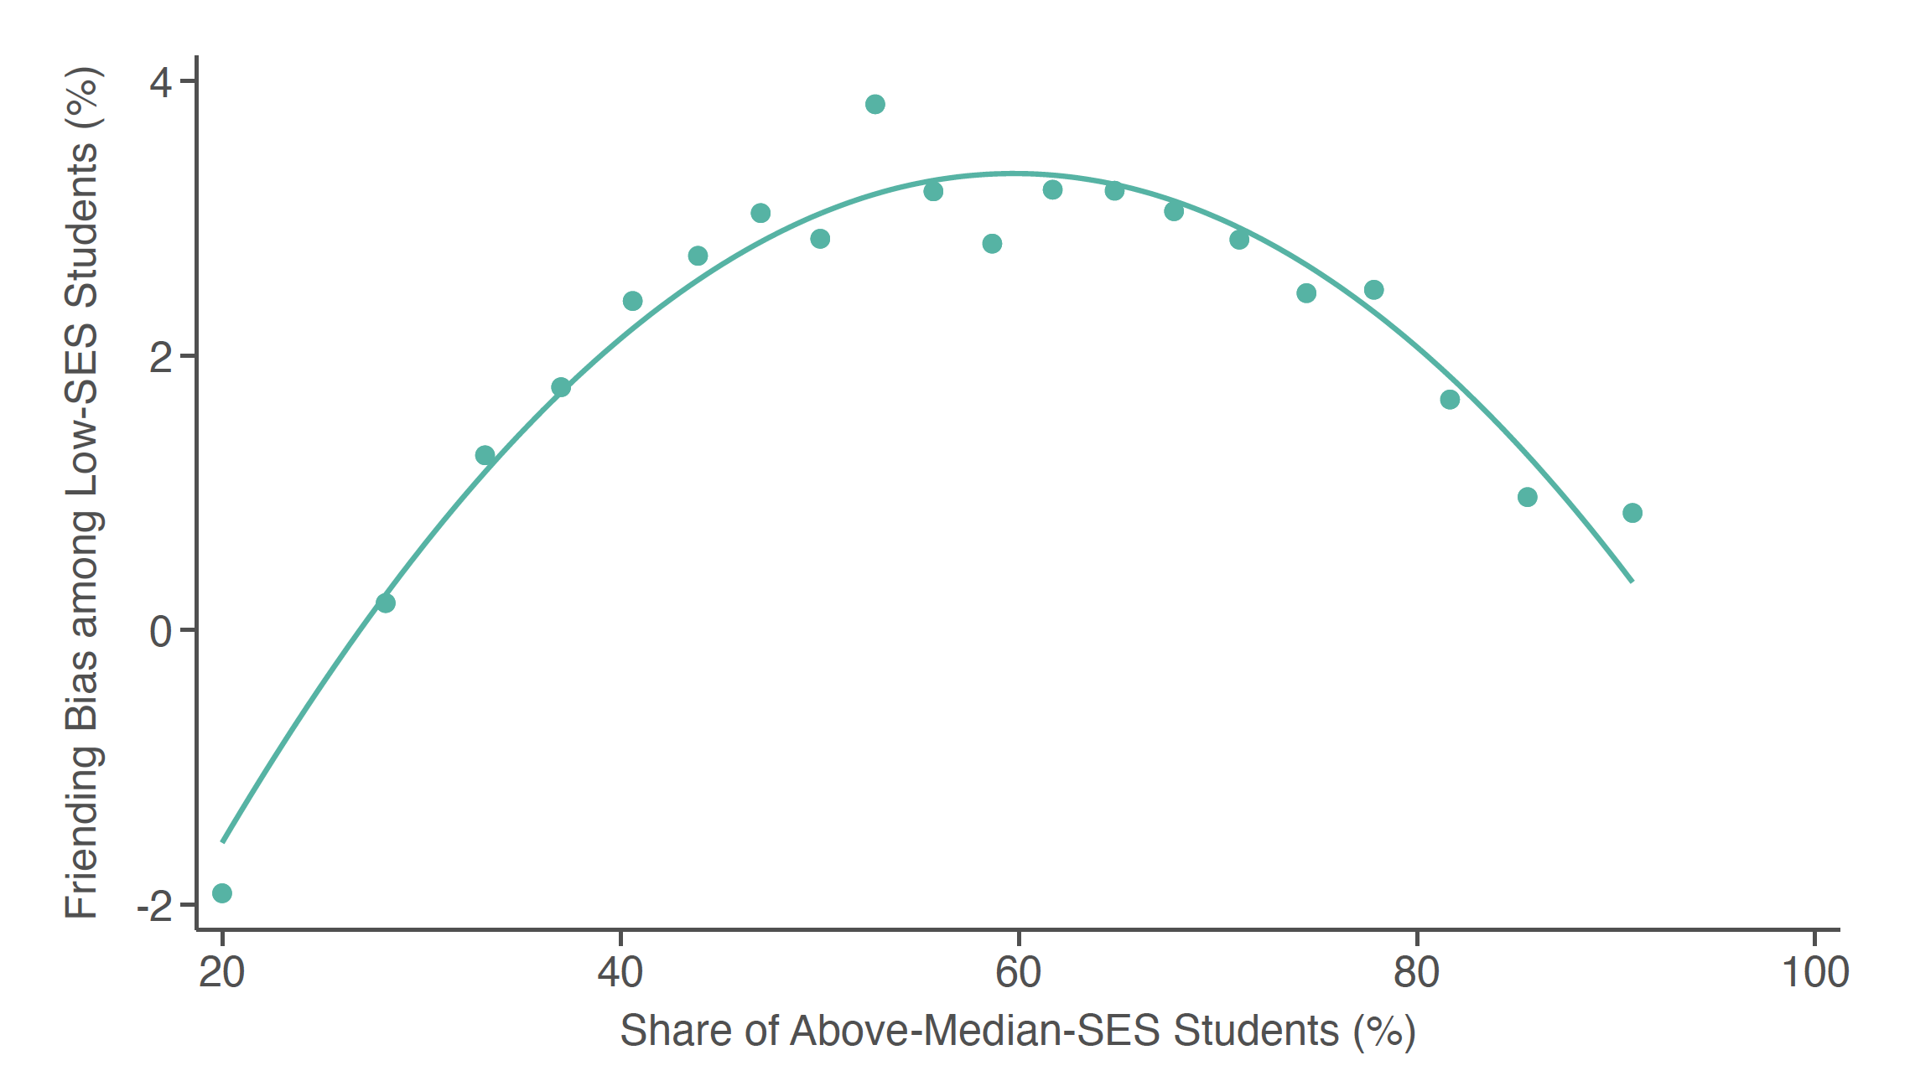
Friending Bias in High Schools vs. Share of High-SES Students
Notes:
2-ED-2D

Slide 21
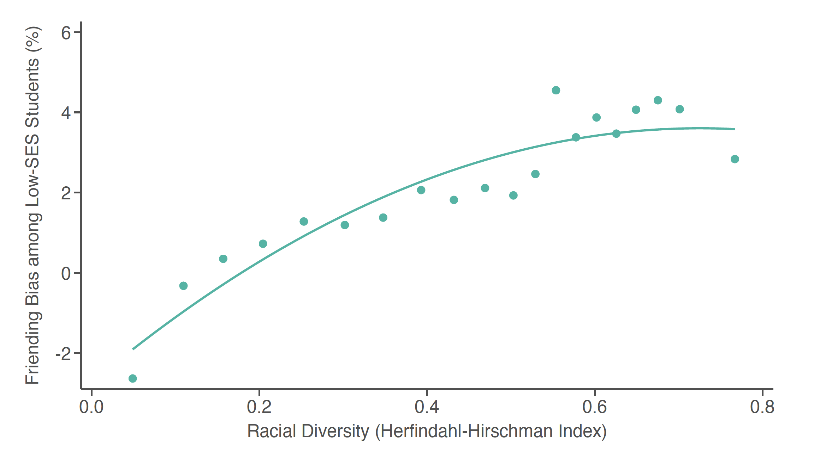
Friending Bias in High Schools vs. Racial Diversity
Notes:
2-ED-2D

Slide 22
Conclusions
Two broad takeaways:
Social capital as measured by economic connectedness appears to be a key mediator of economic mobility
Economic connectedness is shaped by segregation (exposure) and friending bias (interaction), both of which can be measured and shaped by policy

Slide 23
Broader Implications
More generally, social connections appear central in many recent programs that have shown promise in increasing upward mobility
Ex: Creating Moves to Opportunity (neighborhoods) and YearUp (job training) [Bergman, Chetty, DeLuca, Hendren, Katz, Palmer 2020; Katz, Roth, Hendra, Schaberg 2020]
Designing policies going forward to provide not just economic resources but relevant socioeconomic connections may be valuable for expanding opportunity

